Slide 1
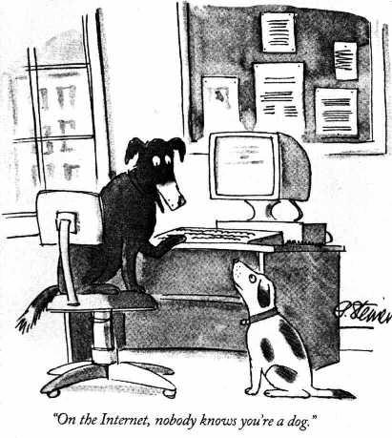
“On the Internet, nobody knows you’re a dog…”

Slide 2

“On the Internet…” You are nothing but an IP Address!
www.redhat.com
66.187.232.50
www.google.com
www.apnic.net
216.239.39.99
202.12.29.20
www.ietf.org
www.ebay.com
4.17.168.6
202.12.29.142
66.135.208.101
www.dogs.biz
www.ebay.com
209.217.36.32
66.135.208.88
www.doggie.com
198.41.3.45
www.gnso.org
199.166.24.5

Slide 3
What is an IP Address?
Internet identifier including information about how to reach a network location
(via the Internet routing system)
IPv4: 32-bit* number. Written in Dotted Decimal Notation
205.150.58.7
4 billion different host addresses
IPv6: 128-bit* number. Written in Hex Decimal Notation
2001:0503:0C27:0000:0000:0000:0000:0000
16 billion billion network addresses
* bit = binary digit

Slide 4
What else is an IP Address?
Necessary for Internet Routing
A finite “Common Resource”
Never “owned” by address users
Are not property
Cannot be bought, sold, traded…
Provided on Non-Permanent Basis for Use
Returned to Provider When No Longer Required
Not dependent upon the DNS

Slide 5
Internet Geography
“Nations” of the Internet are networks
“Frontiers” are border routers
It’s a very dynamic world…
New nations are formed daily
New borders are established hourly
Routing tables change by the minute
Driven almost entirely by industry
No centralised control
Very different from “traditional” networks
Telephony for example

Slide 6
Telephone Network Routing
Global
Prefix Table
+1 +44 +61 +886 +91 …
+61 7 3858 3188
Prefix Table
2 3 7 …
National
+61
Prefix Table
…
Local
7
3858 3188

Slide 7
Internet Address Routing
Global Routing Table
4.128/9 60.100/16 60.100.0/20 135.22/16 …
Global Routing Table
4.128/9 60.100/16 60.100.0/20 135.22/16 202.12.29.0/24 …
The Internet
Announce
202.12.29.0/24
Traffic
202.12.29.0/24
202.12.29.0/24

Slide 8
Internet Address Routing
Traffic
202.12.29.142
Local Routing Table
202.12.29.0/25 202.12.29.128/25
Local Router
202.12.29.142
202.12.29.0/24

Slide 9
Global Internet Routing
Global Routing Table
4.128/9 60.100/16 60.100.0/20 135.22/16 …
The Internet
Net
Net
Net
Net
Net
Net
Net
Net
Net
Net
Net

Slide 10
IP Addresses are not Domain Names
IP Address [Identifier]
“Computer-friendly”
Unique number identifies computer on Internet
Used for routing
DNS Name [Reference]
“People-Friendly”
Maps host name to unique IP address
Not used for routing

Slide 11
IP addresses are not domain names…
The Internet
DNS
www.cernet.cn ?
200.34.46.26
My Computer
200.34.46.26
www.cernet.cn
Notes:
addresses flows between addresses

Slide 12
Definitions
Routing
The act of moving information across an internetwork from a source to a destination.
Domain Name System [DNS]
A means of storing and retrieving information about hostnames and IP addresses in a distributed data base.

Slide 13
Who administers IP address system?
The Internet Assigned Numbers Authority (IANA) delegates Internet resources to the RIRs who, in turn, follow their regional policies to delegate resources to their customers, which include Internet service providers and end-user organizations. Collectively, the RIRs participate in the Number Resource Organization (NRO), formed as a body to represent their collective interests, undertake joint activities, and coordinate their activities globally.

Slide 14
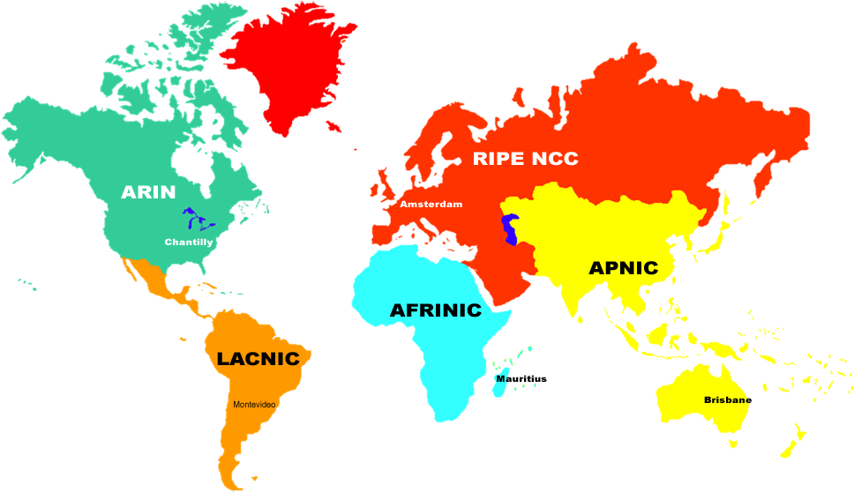





Regional Internet Registry RIR Service Regions
 | 2005
 | 1993
 | 1997
 | 2002
 | 1992
 | 1999
 | 2003
ICANN (pronounced eye-can) is the Internet Corporation for
Assigned Names and Numbers

Slide 15


Number Resource Organization 24 October 2003
Réseaux IP Européens
Network Coordination Centre
Formed by the Regional Internet Registries
to formalize their cooperative efforts, the NRO exists
to protect the unallocated Number Resource pool,
to promote and protect the bottom up policy development process, and
to act as a focal point for Internet community input into the RIR system.
The Internet Assigned Numbers Authority (IANA) delegates Internet resources to the RIRs

Slide 16
IPv4 Addressing Overview

Slide 17
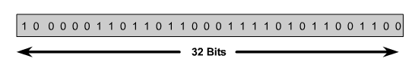

IP Address
An IP address is a 32-bit sequence of 1s and 0s.
To make the IP address easier to use, the address is usually written as four decimal numbers separated by periods.
This way of writing the address is called the dotted decimal format.

Slide 18
Every IP address has two parts:
Network
Host
IP addresses are divided into classes A,B and C to define large, medium, and small networks.
The Class D address class was created to enable multicasting.
Class E addresses for research.

Slide 19
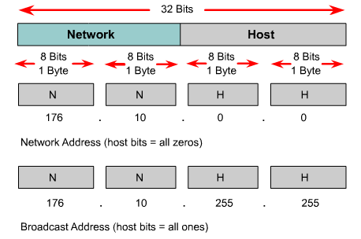
Reserved IP Addresses
Certain host addresses are reserved and cannot be assigned to devices on a network.
An IP address that has binary 0s in all host bit positions is reserved for the network address.
An IP address that has binary 1s in all host bit positions is reserved for the broadcast address.

Slide 20
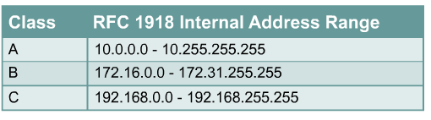
IP Private Addresses
No two machines that connect to a public network can have the same IP address because public IP addresses are global and standardized
Private IP addresses are a solution to the problem of the exhaustion of public IP addresses. Addresses that fall within these ranges are not routed on the Internet backbone:
Connecting a network using private addresses to the Internet requires the usage of NAT (Network Address Translation).

Slide 21
Three levels of addressing
nontri.ku.ac.th
158.108.2.71
Host names (FQDN)
nontri.ku.ac.th
Internet (IP) address
158.108.2.71 (32 bit address with “dotted-decimal” notation)
station Address - hardware address assigned to interface card, referred to as MAC, physical or Ethernet address
e.g. ethernet address 0:0:c:6:13:4a
0:0:c:6:13:4a

Slide 22
Converting Host name to MAC
nontri.ku.ac.th
resolve using host file table (LMHOSTS) or
Domain name System (DNS)
158.108.2.71
resolve by
Address Resolution Protocol(ARP)
0:0:c:6:13:4a

Slide 23
IP Address with router
IP address associated with interface (not machine)
158.108.15.2
158.108.15.3
158.108.16.2
158.108.16.3
Each interface has its own IP Address
Machine with more than one interface is called multi-homed
158.108.15.1
158.108.16.1
192.150.250.201
Router is multi-homed machine
Multi-homed need not to be router
192.150.244.2
192.150.250.211
192.150.244.3
192.150.244.1

Slide 24
Addressing concept
partitions address into 2 fields
network address (path part used by router)
node address (specific device on the net)
1.2
1.3
2.2
2.3
network node
1 1
2
3
2 1
3 1
1.1
2.1
3.1

Slide 25
IP Addressing
32 bits
8,16, 24 bits
from NIC
Network
Host
32 bits
8 bits
8 bits
8 bits
8 bits
158 . 108 . 2 . 71

Slide 26
IP Address Class
32 bit address length, contains 2 parts
network identifier
host identifier
8 16 24 32
class A
0 Network Id Host ID
class B
10 Network Id Host ID
class C
110 Network Id Host ID
class D
1110 Multicast address
class E
1111 unused at present

Slide 27
IP Address Table
initial
class bits net host range
class A 0 7 24 0.0.0.0 127.255.255.255
class B 10 14 16 128.0.0.0 191.255.255.255
class C 110 21 8 192.0.0.0 223.255.255.255
class D 1110 28 - 224.0.0.0 239.255.255.255
class E 11110 27 - 240.0.0.0 247.255.255.255

Slide 28
Problems with IP address assgmt.
class A takes 50% range, class B 25%, class C 12.5%
B
class A
C
D
E
These leads to :
address waste (specially in class A)
running out of ip addresses (Today applying for class A is impossible, class B is very hard to get, class C is running out)

Slide 29
Special Addresses
Host id “all 0s” is reserved to refer to a network number
158.108.0.0, 192.150.251.0
Host id “all 1s” is reserved to broadcast to all hosts on a specific network
158.108.255.255, 192.150.251.255

Slide 30
Special Addresses, cont
0.0.0.0 is reserved and means “this host on this network“. Normally use to boot diskless workstation
255.255.255.255 is reserved to broadcast to every host on the local network
127.x.x.x means “this node” (local loopback). Messages sent to this address will never leave the local host. It’s purpose is testing network software

Slide 31
Network address space
class address spaces usable
A 2^24=16677216 166777214
B 2^16=65536 65534
C 2^8 =256 254

Slide 32
Problem with large networks
Class B “Flat network” more than 65000 hosts
How to manage?
Performance?
158.108.0.1
158.108.0.2
158.108.255.254
Class B “subdivided network” to smaller groups with router
158.108.1.1
158.108.1.2
158.108.2.1
158.108.4.1
158.108.4.2
158.108.3.1

Slide 33
Subnetwork benefits
Increase the network manager’s control over the address space
Easy to allocate the address space
Better network performance
Hide routing structure from remote routers, thus reducing routes in their routing tables
Subdivision of IP network number is an important initial task of network manager

Slide 34
How to assign subnet
Divide host id into 2 pieces
host id
network id subnet adr host addr
choose
appropriate size
Class B address such as 158.108 might use its third byte to identify subnet e.g.
subnet #1 158.108.1.X x=host id range from 1-254
subnet #2 158.108.2.X

Slide 35
Subnet Mask
32 bit number, tells router to recognize the subnet field, call subnet mask
subnet rule:
“The bits covering the network and subnet part of an
address are set to 1”
Example: class B with 8 bit subnet mask
1111 1111 1111 11111 1111 1111 0000 0000
subnet mask= 255.255.255.0
zero bit is used to mask out the host number
resulting in the network address

Slide 36
Subnet mask, cont
Subnet mask 255.255.255.0 for a class B tells:
network has been partitioned into 255 subnets
e.g. 158.108.0.X to 158.108.254.X
bitwise “and” between IP address with mask yields network address
158.108.2.71 158.108.100.98
255.255.255.0 255.255.255.0
158.108.2.0 158.108.100.0
and
and

Slide 37
Subnet mask bits
128 64 32 16 8 4 2 1
1 0 0 0 0 0 0 0 = 128
1 1 0 0 0 0 0 0 = 192
1 1 1 0 0 0 0 0 = 224
1 1 1 1 0 0 0 0 = 240
1 1 1 1 1 0 0 0 = 248
1 1 1 1 1 1 0 0 = 252
1 1 1 1 1 1 1 0 = 254
1 1 1 1 1 1 1 1 = 255

Slide 38
Subnet Class B Example
255.255.0.0 (0000 0000 0000 0000)
1 subnet with 65534 hosts (default subnet)
255.255.192.0 (1100 0000 0000 0000)
4 subnets with 16382 hosts
255.255.224.0 (1110 0000 0000 0000)
8 subnets with 8190 hosts
255.255.255.0 (1111 1111 0000 0000)
255 subnets with 254 hosts
255.255.255.252 (1111 1111 1111 1100)
16384 subnets with 2 hosts

Slide 39
Subnet Class C Example
255.255.255.0 (0000 0000)
1 subnet with 254 hosts (default subnet)
255.255.255.192 (1100 0000)
4 subnets with 62 host
255.255.255.224 (1110 0000)
8 subnets with 30 hosts
255.255.255.240 (1111 0000)
16 subnets with 14 hosts

Slide 40
Subnet interpretation
IP Address subnet mask Interpretation
158.108.2.71 255.255.255.0 host 71 on subnet 158.108.2.0
130.122.34.3 255.255.255.192 host 3 on subnet 130.122.34.0
130.122.34.132 255.255.255.192 host 4 on subnet 130.122.34.128
200.190.155.66 255.255.255.192 host 2 on subnet 200.190.155.64
15.20.15.2 255.255.0.0 host 15.2 on subnet 15.20.0.0

